Slide 1
Semaphore
Semaphore is simply a variable that is non-negative and shared between threads.
A semaphore is a signaling mechanism, and a thread that is waiting on a semaphore can be signaled by another thread.
It uses two atomic operations, 1) Wait, and 2) Signal for the process synchronization.
A semaphore either allows or disallows access to the resource, which depends on how it is set up.
The two common kinds of semaphores are
Counting semaphores
Binary semaphores.

Slide 2
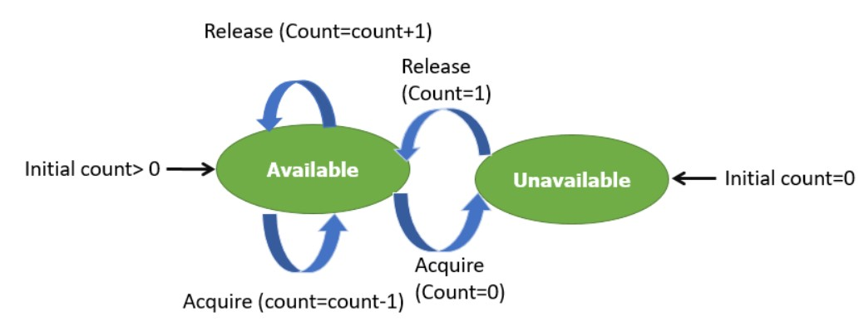
Counting Semaphores
This type of Semaphore uses a count that helps task to be acquired or released numerous times.
If the initial count = 0, the counting semaphore should be created in the unavailable state.
However, If the count is > 0, the semaphore is created in the available state, and the number of tokens it has equals to its count.

Slide 3
Entry Section Code
Down(Semaphore S)
{
S.value=S.value-1;
If(S.value < 0)
{
Put process (PCB) in
Sunspended list sleep();
}
else
Return;
}
Exit Section Code
Up (Semaphore S)
{
S.value=S.value+1;
If(S.value < =0)
{
Select a process from
Sunspended list and
wake up();
}
}

Slide 4
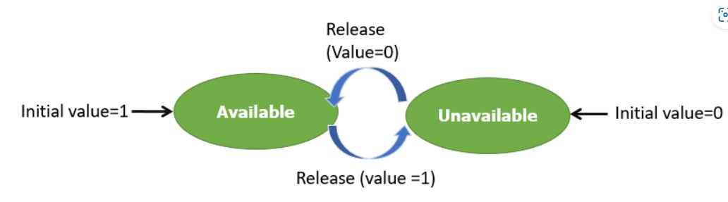
Binary Semaphores
The binary semaphores are quite similar to counting semaphores, but their value is restricted to 0 and 1.
In this type of semaphore, the wait operation works only if semaphore = 1, and the signal operation succeeds when semaphore= 0.
It is easy to implement than counting semaphores.

Slide 5
Entry Section Code
Down( semaphore s)
{
If(s.value == 1)
{
s.value=0;
}
Else
{
block this process and place
In suspended list, sleep();
}
}
Exit Section Code
up( semaphore s)
{
If(suspend list is empty)
{
s.value=1;
}
else
{
Select a process from suspend list and , wake up();
}
}

Slide 6
Wait and Signal Operations in Semaphores
Both of these operations are used to implement process synchronization. The goal of this semaphore operation is to get mutual exclusion.
Wait for Operation
This type of semaphore operation helps you to control the entry of a task into the critical section. However, If the value of wait is positive, then the value of the wait argument X is decremented. In the case of negative or zero value, no operation is executed. It is also called P(S) operation.
After the semaphore value is decreased, which becomes negative, the command is held up until the required conditions are satisfied

Slide 7
Copy CodeP(S)
{
while (S<=0);
S--;
}

Slide 8
Signal operation
This type of Semaphore operation is used to control the exit of a task from a critical section. It helps to increase the value of the argument by 1, which is denoted as V(S).
Copy Code P(S)
{
while (S>=0);
S++;
}

Slide 9
Counting Semaphore vs. Binary Semaphore
Counting Semaphore | Binary Semaphore
No mutual exclusion | Mutual exclusion
Any integer value | Value only 0 and 1
More than one slot | Only one slot
Provide a set of Processes | It has a mutual exclusion mechanism.

Slide 10
Classical Problems of Synchronization
The classical problems of synchronization are as follows:
Bound-Buffer problem
Sleeping barber problem
Dining Philosophers problem
Readers and writers problem

Slide 11
Bound-Buffer problem
Also known as the Producer-Consumer problem. In this problem, there is a buffer of n slots, and each buffer is capable of storing one unit of data.
There are two processes that are operating on the buffer – Producer and Consumer.
The producer tries to insert data and the consumer tries to remove data.
If the processes are run simultaneously they will not yield the expected output.
The solution to this problem is creating two semaphores, one full and the other empty to keep a track of the concurrent processes.

Slide 12
Sleeping Barber Problem
This problem is based on a hypothetical barbershop with one barber.
When there are no customers the barber sleeps in his chair.
If any customer enters he will wake up the barber and sit in the customer chair.
If there are no chairs empty they wait in the waiting queue.

Slide 13
Dining Philosopher’s problem
This problem states that there are K number of philosophers sitting around a circular table with one chopstick placed between each pair of philosophers.
The philosopher will be able to eat if he can pick up two chopsticks that are adjacent to the philosopher.
This problem deals with the allocation of limited resources.

Slide 14
Readers and Writers Problem
This problem occurs when many threads of execution try to access the same shared resources at a time.
Some threads may read, and some may write. In this scenario, we may get faulty outputs.

Slide 15
Monitors in process synchronization
The monitor is one of the ways to achieve Process synchronization. The monitor is supported by programming languages to achieve mutual exclusion between processes. For example Java Synchronized methods. Java provides wait() and notify() constructs.
It is the collection of condition variables and procedures combined together in a special kind of module or a package.
The processes running outside the monitor can’t access the internal variable of the monitor but can call procedures of the monitor.
Only one process at a time can execute code inside monitors.

Slide 16
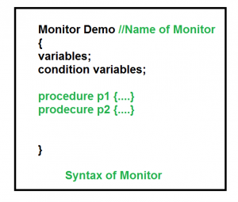
Syntax:

Slide 17
Condition Variables: Two different operations are performed on the condition variables of the monitor.
Wait. signal
let say we have 2 condition variables condition x, y; // Declaring variable

Slide 18
Wait operation
x.wait() : Process performing wait operation on any condition variable are suspended. The suspended processes are placed in block queue of that condition variable.
Note: Each condition variable has its unique block queue.

Slide 19
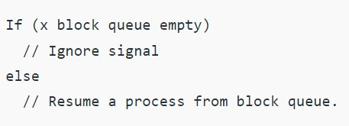
Signal operation x.signal(): When a process performs signal operation on condition variable, one of the blocked processes is given chance.

Slide 20
Advantages of Monitor:
Monitors have the advantage of making parallel programming easier and less error prone than using techniques such as semaphore.
Disadvantages of Monitor:
Monitors have to be implemented as part of the programming language . The compiler must generate code for them. This gives the compiler the additional burden of having to know what operating system facilities are available to control access to critical sections in concurrent processes. Some languages that do support monitors are Java,C#,Visual Basic,Ada and concurrent Euclid.

